Slide 1









My Number
Interactive Notebook
$$×$$
$$\frac{1}{2}$$
$$÷$$
$$+$$
$$−$$
$$\frac{3}{5}$$
$$7$$
Name
Class
Teacher
Term 1 Semester 1
$$5^{2}$$
$$\sqrt{9}$$
1

Slide 2
Contents
Glossary or Formula Page
Page
Date
Description
2
3

Slide 3
Tasks
24
7
30
Essential Question
Questions
Notes
Summary
6
7

Slide 4
24
7
30
Date
Prime Factorisation
EQ – How do I write numbers as a product of prime factors?

Slide 5
24
7
30
Date
Prime Factorisation
EQ – How do I write numbers as a product of prime factors?
How do I find the prime factors?
Use a factor tree to write 540 as a product of prime factors.
Find 2 numbers x to give 540
540

Slide 6
24
7
30
Date
Prime Factorisation
EQ – How do I write numbers as a product of prime factors?
How do I find the prime factors?
Use a factor tree to write 540 as a product of prime factors.
Find 2 numbers x to give 540
540
Circle any primes
prime
2
270

Slide 7
24
7
30
Date
Prime Factorisation
EQ – How do I write numbers as a product of prime factors?
How do I find the prime factors?
Use a factor tree to write 540 as a product of prime factors.
Find 2 numbers x to give 540
540
Circle any primes
prime
2
270
Continue dividing until all factors are prime
prime
2
135

Slide 8
24
7
30
Date
Prime Factorisation
EQ – How do I write numbers as a product of prime factors?
How do I find the prime factors?
Use a factor tree to write 540 as a product of prime factors.
Find 2 numbers x to give 540
540
Circle any primes
prime
2
270
Continue dividing until all factors are prime
prime
2
135
27
5
prime

Slide 9
24
7
30
Date
Prime Factorisation
EQ – How do I write numbers as a product of prime factors?
How do I find the prime factors?
Use a factor tree to write 540 as a product of prime factors.
Find 2 numbers x to give 540
540
Circle any primes
prime
2
270
Continue dividing until all factors are prime
prime
2
135
27
5
prime
prime
3
9

Slide 10
24
7
30
Date
Prime Factorisation
EQ – How do I write numbers as a product of prime factors?
How do I find the prime factors?
Use a factor tree to write 540 as a product of prime factors.
Find 2 numbers x to give 540
540
Circle any primes
prime
2
270
Continue dividing until all factors are prime
prime
2
135
27
5
prime
prime
3
9
prime
3
3
prime

Slide 11
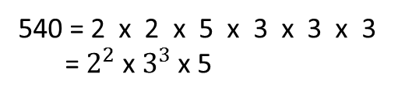
24
7
30
Date
Prime Factorisation
EQ – How do I write numbers as a product of prime factors?
How do I find the prime factors?
Use a factor tree to write 540 as a product of prime factors.
Find 2 numbers x to give 540
540
Circle any primes
prime
2
270
Continue dividing until all factors are prime
prime
2
135
27
5
prime
prime
3
9
Write the primes in ascending order
prime
3
3
prime
540 = 2 x 2 x 5 x 3 x 3 x 3
= $2^{2}$ x $3^{3}$ x 5

Slide 12
Task
Let’s work through another example together.
Write 84 as a product of prime factors

Slide 13
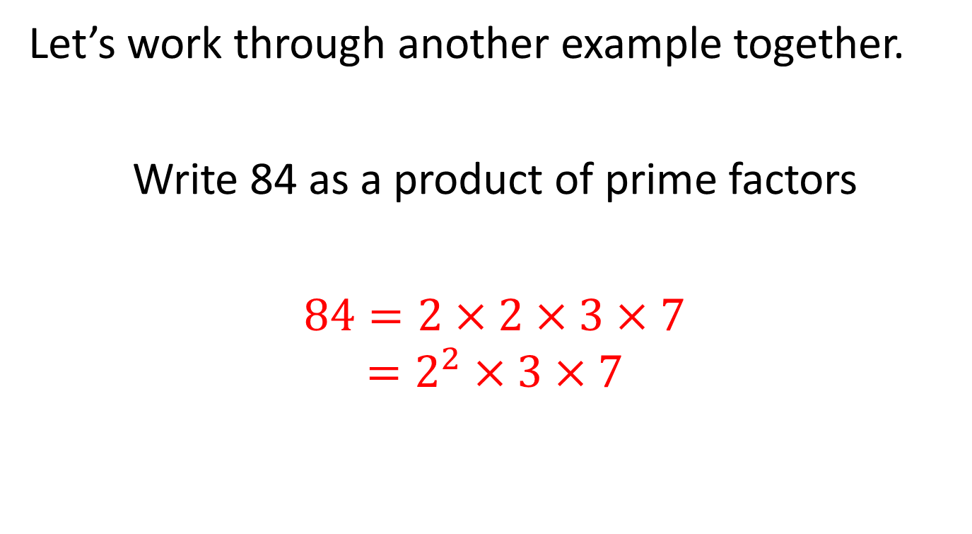
Task
Let’s work through another example together.
Write 84 as a product of prime factors
$84=2×2×3×7$
$$=2^{2}×3×7$$

Slide 14
Notes Review
24, 7 ,30
Date
Title
Essential question
Notes complete
Notes complete with colour and diagrams
Questions completed
Contents page filed in
Formula page filled in

Slide 15
Homework
Review your notes and write a summary answering the essential question.

